Slide 1
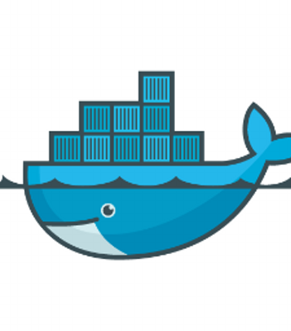
Docker Architecture & Docker Networking
Hussaina Begum N.
Staff Engineer, VMware

Slide 2
Agenda
History of Compute Virtualization
Linux Containers(LXC)
Microservices architecture
What are Dockers ?
Docker Architecture
Docker Hands-On
Docker networking
Single-Host, Multi-Host networking demos
Q&A

Slide 3
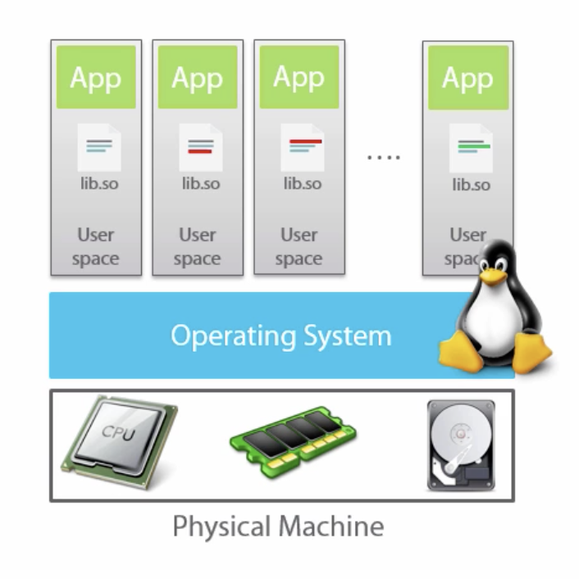
Long time ago in a galaxy far far away …
Physical servers
Monolithic applications
Scaling is hard and expensive
@nigelpoulton

Slide 4
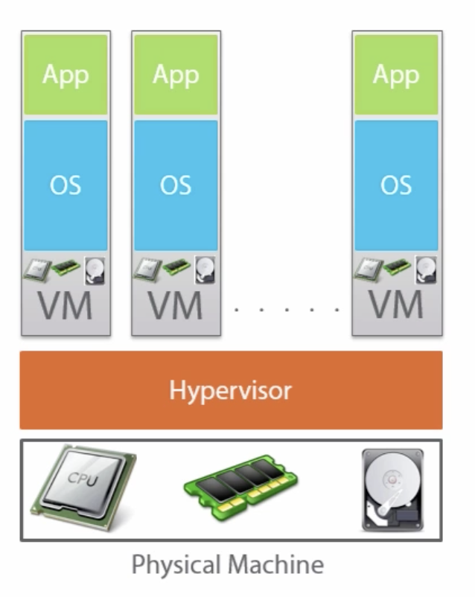
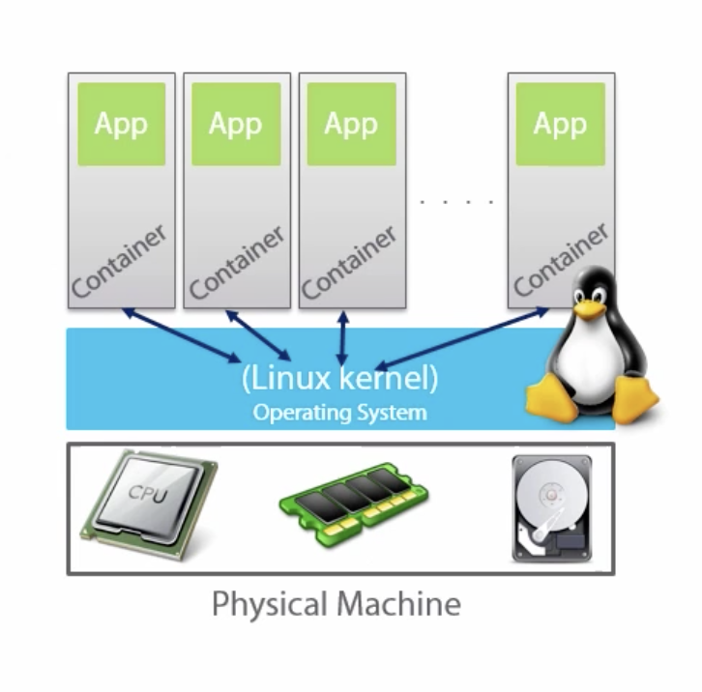
History
VMs vs. containers
@nigelpoulton
Notes:
https://www.ibm.com/cloud/learn/hypervisors
Motivation behind dockers - Matrix of hell

Slide 5
Linux Containers (LXC)
Something in between chroot and VM
Uses the below constructs to achieve containers
Kernel namespaces (ipc, uts, mount, pid, network and user)
Apparmor and SELinux profiles
Seccomp policies
Chroots (using pivot_root)
Kernel capabilities
Cgroups (control groups)
Notes:
sudo cat /proc/sys/kernel/cap_last_cap
sudo capsh –print
getpcaps <pid>
$ getpcaps 1549
Capabilities for `1549': = cap_dac_override,cap_net_bind_service,cap_net_admin,cap_net_raw,cap_sys_module+ep
$ps -o cgroup 1549
CGROUP
10:blkio:/system.slice/ifup@ens160.service,9:pids:/system.slice/ifup@ens160.service,7:memory:/system.slice/ifup@ens160.service,4:devices:/system.slice/ifup@ens160.service,2:cpu,cpuacct:/system.slice/ifstem
$ sudo apparmor_status
$ cat /etc/apparmor.d/usr.sbin.sssd
Is a Linux kernel security module that allows the system administrator to restrict programs' capabilities with per-program profiles. Profiles can allow capabilities like network access, raw socket access, and the permission to read, write, or execute files on matching paths.

Slide 6
Linux Containers (LXC) ➔ Docker
LXC + aufs → dotCloud (dc)
Changes to LXC broke dc
dc came up with libcontainer abstraction
dc -> docker daemon – 2013
docker daemon is bloated(monolith)
Open Container Initiative (runtime spec, image spec) - 2015
docker refactoring
Notes:
Open Container Initiative
Runtime Spec : https://github.com/opencontainers/runtime-spec/blob/master/spec.md
CNI Spec: https://github.com/containernetworking/cni/blob/master/SPEC.md
Image Spec: https://github.com/opencontainers/image-spec/blob/master/spec.md
dotCloud to docker
https://jpetazzo.github.io/2017/02/24/from-dotcloud-to-docker/

Slide 7
Microservices Architecture
Monolithic applications are
Inflexible
Unscalable
Unreliable
Slow development(same framework for all components)
Microservices
Small autonomous services
Independent and loosely coupled components
Can scale each component
Stateless components
Redeployment
Small focused, loosely coupled, language independent, bounded context
https://blog.newrelic.com/technology/microservices-what-they-are-why-to-use-them/
Notes:
https://blog.newrelic.com/technology/microservices-what-they-are-why-to-use-them/

Slide 8
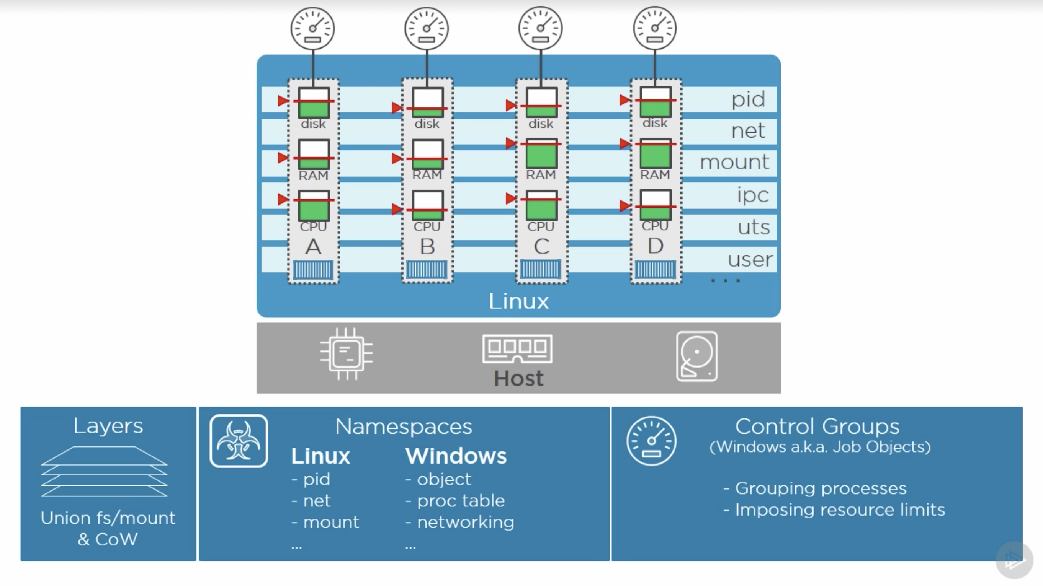
Dockers
OS level virtualization
Shares host kernel
Multi-layered FS
Union FS(overlay2), mount, CoW
Namespaces
pid, net, mnt, ipc, uts, user
Cgroups
Grouping procs, rlimits
@nigelpoulton

Slide 9
Docker on Windows/Mac
Docker Toolbox (not a native solution)
Virtual Env, boot2docker, Docker Engine, Docker Machine, Docker compose
Network, storage is not shared from host
Mac Native Docker (2016)
HW virtualization, Embedded Linux, unikernel, docker engine
Windows Native Docker(2016)
Windows Server based
Leverages namespace, cgroup of windows kernel
Host kernel is shared
Hyper-V based
Containers run in highly optimized VM
Host kernel is not shared
Notes:
OSX - hyperkit
docker-machine create --driver virtualbox default
docker-machine ls

Slide 10
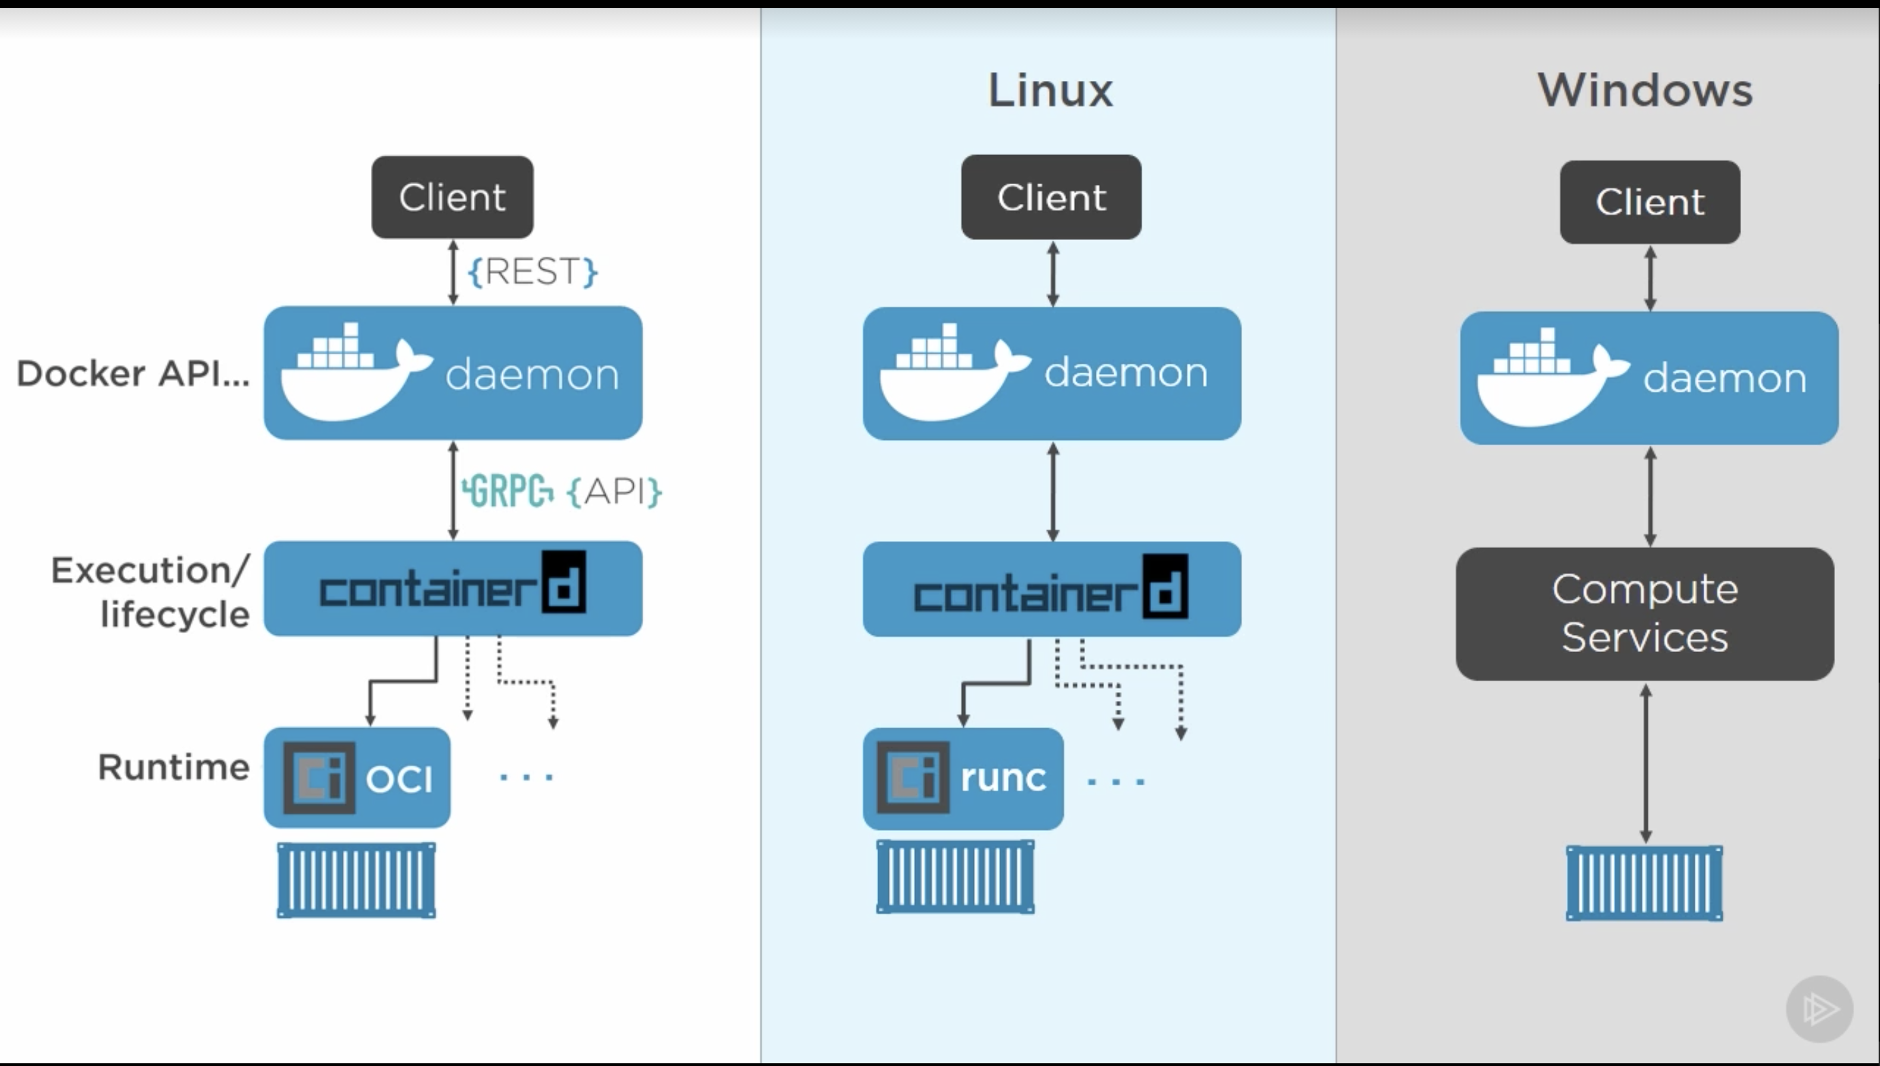
Docker Engine
API server
Docker daemon
containerd
Runtime
runc
Rkt – retired
Cri-o (for k8s)
kata-runtime
@nigelpoulton
Notes:
https://docs.docker.com/get-started/overview/
Open Container Initiative : https://github.com/opencontainers/runtime-spec/blob/master/spec.md
Dockerd (orchestration, build, network stack, overlay networks)
Listen to API requests
Manages container life cycle
/var/run/docker.sock
Containerd(implements basic network, storage, image distribution)
Image pull/push
Storage mgmt(image, snapshot, diff)
Exec containers by calling runc
Network mgmt.
Full OCI support
runc
https://github.com/opencontainers/runc
https://cri-o.io
docker, docker-containerd, docker-containerd-shim, and docker-runc.
sudo docker info|grep -i runtime
docker run -d alpine sleep 60
ps fxa | grep docker -A 3
Runtime ref: https://github.com/kata-containers/documentation/blob/master/design/architecture.md

Slide 11
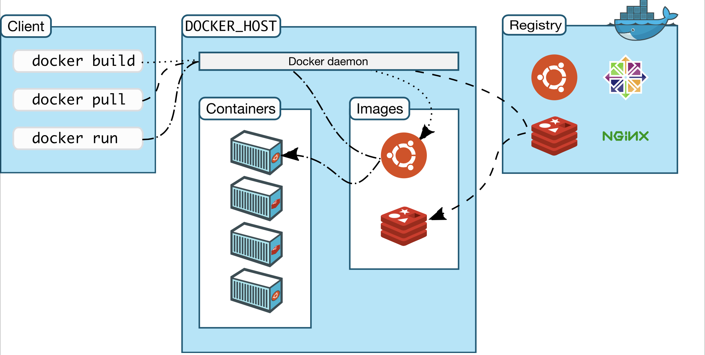
Docker workflow
Image
Container
Registry
Image @docker.com
Notes:
Image – A template RO filesystem(layered), which will be shared across containers
Container – secure and isolated container created from an image, which can run/start/stop/move/delete’d
Registry – Secure repository of images

Slide 12
Dockers – Install/HandsOn
Docker install on Ubuntu/Mac/Windows
docker info – lists the docker engine details on the host(client and server versions)
docker pull <image> – pulls image to docker host
docker run – starts a new container
docker stop – stops the container
docker ps – lists current running containers
docker images – lists the images on docker host
docker rmi – removes image from docker host
Notes:
24 vim /etc/apt/sources.list
25 apt update
26 sudo apt-get remove docker docker-engine docker.io
27 sudo apt install docker.io
28 sudo systemctl enable docker
29 docker --version
30 docker ps
31 docker info
$ sudo apt-get remove docker docker-engine docker.io
$ curl -fsSL get.docker.com -o get-docker.sh
$ sudo sh get-docker.sh
$ sudo usermod -aG docker <your-user>
$ docker –version
$ docker run hello-world
$ docker run --detach --publish=80:80 --name=webserver nginx #access http://localhost/
https://phoenixnap.com/kb/list-of-docker-commands-cheat-sheet

Slide 13
Dockerfile
CAPITALIZED instructions
<INSTRUCTION> - <value>
FROM
LABEL
RUN
COPY
WORKDIR
ENTRYPOINT
CMD
Notes:
docker build -t image .
=========
FROM alpine
LABEL maintainer "hnandyala@vmware.com"
RUN apk add --update python
COPY . /src
WORKDIR /src
ENTRYPOINT ["python", "./hello-world.py"]
CMD [”WWCodePune"]
======
$ cat hello-world.py
import sys
arguments = len(sys.argv)
if (arguments <= 1):
print('Hello, world!')
else:
print('Hello, %s!' % (sys.argv[1]))

Slide 14
Container Networking
CNM – by Docker
Sandbox - network stack, routing tables, DNS settings
Endpoint - veth-pair, vSwitch port
Network - connected endpoints
CNI – by coreOS (approved by CNCF)
CNI Specification - https://github.com/containernetworking/cni/blob/master/SPEC.md
Plugins
Library
Notes:
https://www.nuagenetworks.net/blog/container-networking-standards/
Container Networking Model :
Sandbox — A Sandbox contains the configuration of a container's network stack. This includes the management of the container's interfaces, routing table, and DNS settings. An implementation of a Sandbox could be a Windows HNS or Linux Network Namespace, a FreeBSD Jail, or other similar concept. A Sandbox may contain many endpoints from multiple networks.
Endpoint — An Endpoint joins a Sandbox to a Network. The Endpoint construct exists so the actual connection to the network can be abstracted away from the application. This helps maintain portability so that a service can use different types of network drivers without being concerned with how it's connected to that network.
Network — The CNM does not specify a Network in terms of the OSI model. An implementation of a Network could be a Linux bridge, a VLAN, etc. A Network is a collection of endpoints that have connectivity between them. Endpoints that are not connected to a network do not have connectivity on a network.
CNM->Libnetwork(socket plane)->Drivers
https://www.cncf.io/blog/2017/05/23/cncf-hosts-container-networking-interface-cni/
Container Network Interface :
CNI Specification: defines an API between runtimes and network plugins for container network setup. No more, no less.
Plugins: provide network setup for a variety of use-cases and serve as reference examples of plugins conforming to the CNI specification
Library: provide a Go implementation of the CNI specification that runtimes can use to more easily consume CNI
- https://github.com/containernetworking/cni
- https://github.com/containernetworking/cni/blob/master/SPEC.md

Slide 15
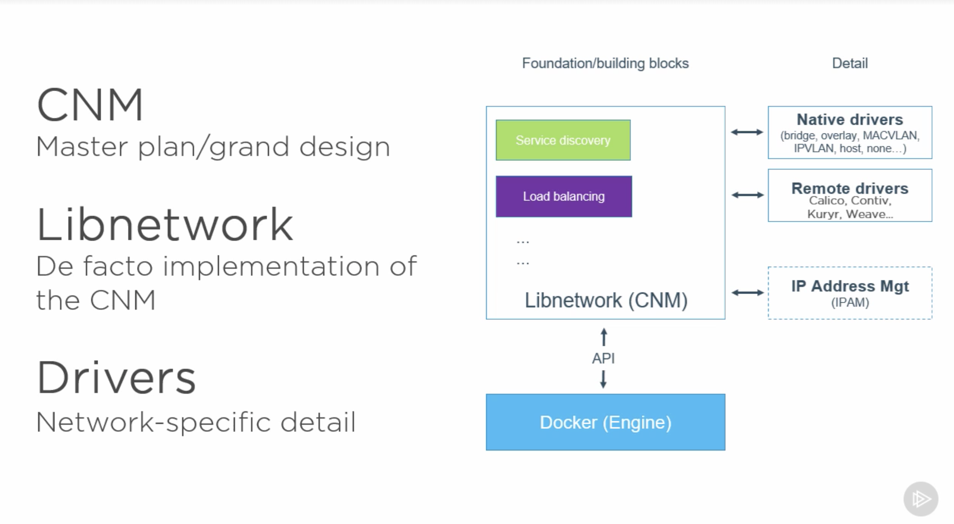
Dockers – Networking
CNM
Sandbox – namespaces
Endpoint - interfaces
Network – connected endpoints
Libnetwork
Drivers
host
bridge
none
Remote(overlay, macvlan)
plugins
@nigelpoulton
Notes:
Alternative - https://github.com/containernetworking/cni
https://success.docker.com/article/networking#dockernetworksecurityandencryption

Slide 16
Dockers – Networking CLIs
docker network ls
docker info
docker network create
docker network connect
docker network disconnect
Notes:
$ docker run -dit --name alpine1 alpine ash
$ docker run -dit --name alpine2 alpine ash
$ docker container ls
$ docker network inspect bridge
$ docker attach alpine1
# ip addr show
# ping -c 2 google.com
# ping -c 2 172.17.0.3
# ping -c 2 alpine2
CTRL + p CTRL + q
$ docker container stop alpine1 alpine2
$ docker container rm alpine1 alpine2

Slide 17
Dockers – Single Host Networking
Drivers that are available on host
Bridge(default)
Host
None
Create two containers
Create a bridge n/w with subnet
Attach bridge n/w to two containers
Containers can talk to each other over bridge n/w. i.e, by ip or by container-name
Image @docker.com
Notes:
Single Host
==========
docker run -d --name c1 -p 8001:80 nginx:1.16.0-alpine
docker run -d --name c2 -p 8002:80 nginx:1.16.0-alpine
docker network create -d bridge --subnet 10.0.0.1/24 bridge1
docker network connect bridge1 c1
docker network connect bridge1 c2
docker network inspect bridge1
docker exec -ti c1 ash
sed -i 's/Welcome to nginx/Welcome to container1/g' /usr/share/nginx/html/index.html
exit
docker exec -ti c2 ash
sed -i 's/Welcome to nginx/Welcome to container2/g' /usr/share/nginx/html/index.html
exit
docker exec -ti c1 ash
curl c1
curl c2
docker network disconnect bridge1 c1
docker network disconnect bridge1 c2
docker network rm bridge1
docker stop c1 c2
docker rm c1 c2
https://docs.docker.com/network/network-tutorial-standalone/

Slide 18
Dockers – Multi Host Networking
Overlay driver needs to be used for connectivity.
Create two containers on two different nodes
Node1 - docker swarm init
Node2 - docker swarm join
Create network using ‘overlay’ driver
Create a docker service with 2 replicas
Containers can talk to each other, using overlay network
@nigelpoulton
Notes:
Multi-Host
========
docker swarm init
docker swarm join <….>
docker create network -d overlay demo-overlay
docker service create --name <service-name> --network <overlay-driver> --replicas <> image-name

Slide 19
Dockers – Orchestration
docker compose(single host)
-link command
docker swarm (multi-host)
swarm init
swarm join
kubernetes
Notes:
docker swarm init --advertise-addr=<IP-ADDRESS-OF-MANAGER>
docker swarm join <….>
docker service create --name service-name --network network-name --replicas number-of-containers image-name
docker-compose -d <filename.yaml> up

Slide 20
References
https://docs.docker.com
https://success.docker.com/article/networking
Pluralsight courses
https://app.pluralsight.com/profile/author/nigel-poulton
Docker Deep Dive
Docker Networking
Linux Foundation courses
Container Fundamentals (LFS253) - https://vmware.sabacloud.com/Saba/Web_spf/NA1PRD0121/common/ledetail/cours000000000035007
Kubernetes Fundamentals - https://vmware.sabacloud.com/Saba/Web_spf/NA1PRD0121/common/ledetail/cours000000000035010

Slide 21
Thank you!!
Questions ?

